Slide 1
CS 151 Prep: How to use Vim More Effectively
Author: Chris Wolf
E-mail: crwolf3@catamount.wcu.edu
Phone: (919)770-2878

Slide 2
Note About Code
You are learning Java in CS151 so all code examples in this session will be in Java. There may be code that you have not seen before. Do not worry, that is not the purpose of this practice session. I am only using Java to get you exposed to more Java code. Any code that matters to what we are doing, we will lightly go over so you can understand the text we are trying to edit.

Slide 3
Practice Files
Go to https://www.github.io/chriswolfdesign/vimpractice/index.html
Download the vimpractice.zip file
Unzip file
Move folder to agora with WinSCP
We will do all of this together

Slide 4
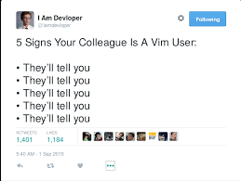

Slide 5

I’m a vim user and I haven’t told anybody in 20 minutes

Slide 6
What is Vim?
Extension of the code editor vi
Short for “vi improved”
Okay, then what is vi?
Short for VIsual editor
Developed by Bill Joy in 1976, a graduate from University of California at Berkeley
Inspired by Couloris’s editor “em” (editor for mortals) due to his hatred for “ed”

Slide 7
Why Use Vim?
Available in some form on all popular Operating Systems (Windows, OSX, Linux)
Lightweight
Feature Rich
Command Line Editor (Able to use in a ssh terminal)
Inspires many other code editor/IDE “vim modes”
It’s MODAL!!!!

Slide 8
Modal, what does that mean?
Modal means Vim has many different modes, or states, it can be in to perform different actions
Modes allow us to do more with the limited keys we have on our keyboard
Modes allow our hands to stay on the home row of our keyboard, eliminating hand movement time
Modes also eliminate the need for a mouse in code editing
Vim is a language, learning to speak it will allow you to communicate with it much easier

Slide 9
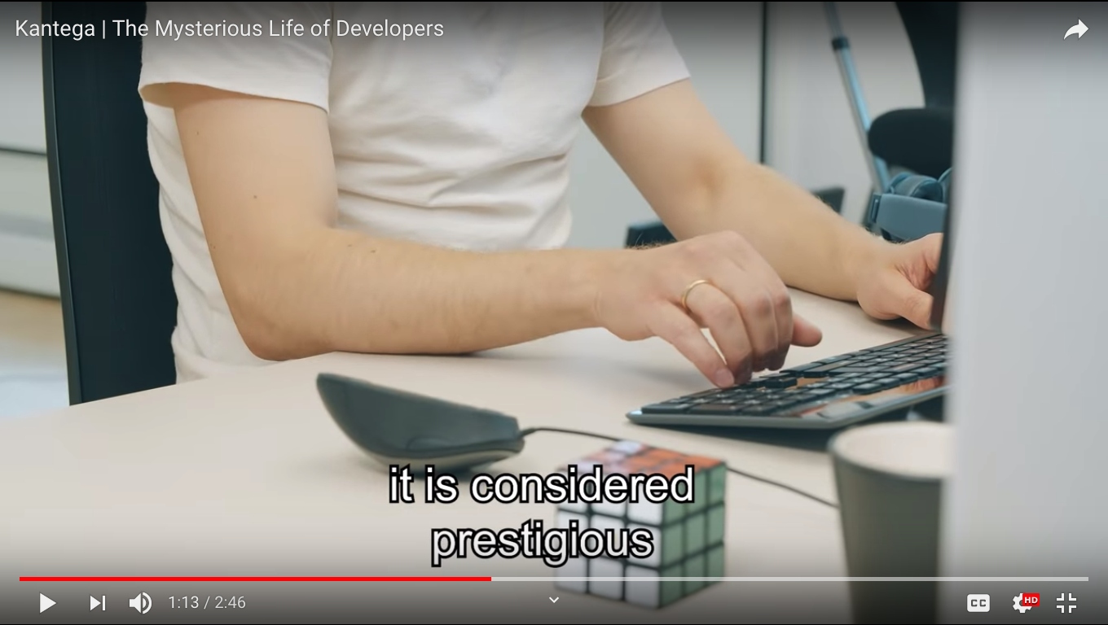
No need for a mouse

Slide 10
Mode 1: Normal Mode
Nickname: Default Mode
This is the mode you want to be in as much as possible
How to Enter: Press Escape while in any other mode
Movement:
j=Down
k=up
h=left
l=right
Can move with arrow keys: DON’T DO IT!!!!!!!!
Practice file: normalmode/normalmode.txt

Slide 11
More Movement Commands
Go To End of File: G
Go To Beginning of File: gg
Go to end of line: $
Go to beginning of line: 0
Go a number of movements: {number}{movement}
Ex. Go down 5 lines: 5j
Find character :f{char}
Ex. Find a ( later in the line: f(
Find character behind you: F{char}
Find a & early in the line: F&

Slide 12
More Movement Commands
Search for entire word in file: /{word}<Enter>
Find the word print in your file: /print<Enter>
Keep searching for the same word later in the file: n
Keep searching for the same word earlier in the file: N
End of word: e
Next word: w
Back one word: b
Think of these in terms of language: b for Back, w for Word, f for Find, etc.

Slide 13
Mode 2: Insert Mode
Nickname: Typing Mode
Used to type like a more traditional text editor
Goal: Minimize your time in insert mode
How To Enter: Many ways but the easiest is i for Insert
Practice File: insertmode/insertmode.txt

Slide 14
More ways to enter insert mode
Start writing after current character: a for Append
Start writing at the end of the line: A
Change current text: c <- extendable command
Extendable command means it can be extended by further input
Ex. to change everything between two “: ci” for Change In “
Start a new line below current line and enter insert mode: o
Start a new line above current line and enter insert mode: O
Remember: MINIMIZE THE TIME YOU ARE IN INSERT MODE

Slide 15
More useful editing commands
Delete: d <- extendable command
Delete everything to the end of the line: d$ for Delete to end of line
Delete an entire line: dd
Copy an entire line: yy for Yank
Paste: p for Paste
Example file: editing/Driver.java

Slide 16
Mode 3: Visual Mode
Nickname: Highlight mode
Use: It allows us to highlight text in your file
Think clicking and dragging your mouse over text
This is the mode that vim is named for; it was revolutionary for its time
Enter: a few ways but most basic is v for Visual
Practice file: visualmode/visualmode.txt
Use any movement keys while in visual mode to highlight all the text you have moved over
Can easily be combined with yank and paste
Visual Line Mode: same as visual mode but takes in entire lines: V

Slide 17
Mode 4: Command Mode
Nickname: Swiss Army Knife mode
Use: can tell vim to complete varying actions
Enter: Type : then add your command
Save a file: :w<Enter> for Write
Exit a file: :q<Enter> for Quit
Force vim to complete an action it doesn’t want to: Add ! after the command
Example: quit vim without saving even though you have made revisions:
:q! (NOT RECOMMENDED DUE TO LOSS OF CHANGES)

Slide 18
More vim commands
Edit another file while inside of vim: :edit <filename>
Example: You’re in Hello.java but want to edit Goodbye.java: :edit Goodbye.java
Run a command in the terminal while you’re still in vim: Add ! before the command
Example: You want to compile Goodbye.java without leaving vim:
:! javac Goodbye.java
Find and replace all instances of a word in a file: :%s/<old_word>/<new_word>/g
Example: Replace emacs with vim throughout a file: :%s/emacs/vim/g
Practice file: commandmode/commandmode.txt

Slide 19
Changing settings
Vim is amazing out of the box, but sometimes we want to make minor changes
Enter your settings file by opening the file with vim: vim ~/.vimrc

Slide 20
Common vim settings
Show the line numbers beside each line: set number
Show the relative line number (1 line above, 5 lines below, etc):
set relativenumber (This is helpful for going up or down a certain number of lines with the j and k movement commands)
Note: Having both number and relativenumber set will cause the current line to show its actual line number but every other line will show its relative line number

Slide 21
More vim settings
Add a line to tell you when you’ve reached a certain line length:
set colorcolumn=80 (80 is the expected line length for this course)
Have the line you are on underlined (makes it easier to keep track of where your cursor is): :set cursorline
Remap keys: noremap <new key combination><old key>
Example, return to normal mode with jk: noremap jk <Esc>

Slide 22
Tmux - Another thing to learn!?!?!?!?
NOT REQUIRED FOR THIS COURSE
Tmux is a Terminal MUltipleXer
Allows you to have multiple terminals open in one terminal window
Helpful for not leaving vim to compile and run files
Enter tmux by inputting the command “tmux” into your terminal
You will know it worked by the green bar at the bottom of your terminal
To enter tmux’s command mode: enter control-b

Slide 23
Helpful tmux commands
Rename current pane: ,
Create a new pane: c
Move to a different pane: <pane number>
To close a pane: x
To leave tmux: close every pane
NOTE: Be sure you have saved and closed all vim instances before closing their pane, failure to do so can cause some strange save files

Slide 24
Vim Plugins
NOT REQUIRED FOR THIS CLASS
Adds more powerful features to vim
Guide to managing vim plugins: https://gist.github.com/manasthakur/ab4cf8d32a28ea38271ac0d07373bb53
I recommend the vundle package manager but any will do.
Recommended vim plugins: NERDTree, ctrlp, autopairs
Find your own and experiment with them!

Slide 25
Additional Resources
Vim Golf: https://www.vimgolf.com
Vim Adventures: https://www.vim-adventures.com
Vim Tutor: type vimtutor into agora
Me!
Dr. Barlowe and Dr. Kreahling
Vim reddit: https://www.reddit.com/r/vim/
Countless online videos and tutorials

Slide 26
How to Continue Learning Vim
Watch online videos about how other users use vim
Research more plugins and settings
PRACTICE
PRACTICE
PRACTICE

